Slide 1
SQL Join Operations

Slide 2
Outline
SQL Join Types
Inner Join
Natural Join
Outer Join
Notes:
1

Slide 3
Joined Relations
Join operations take two relations and return as a result another relation.
A join operation is a Cartesian product which requires that tuples in the two relations match (under some condition). It also specifies the attributes that are present in the result of the join
The join operations are typically used as subquery expressions in the from clause
There are different types of joins in SQL:
Inner join
Natural join
Outer join

Slide 4
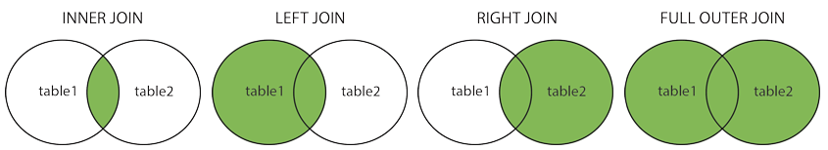
SQL Join Types
(INNER) JOIN: Returns records that have matching values in both tables
LEFT (OUTER) JOIN: Returns all records from the left table, and the matched records from the right table
RIGHT (OUTER) JOIN: Returns all records from the right table, and the matched records from the left table
FULL (OUTER) JOIN: Returns all records when there is a match in either left or right table

Slide 5
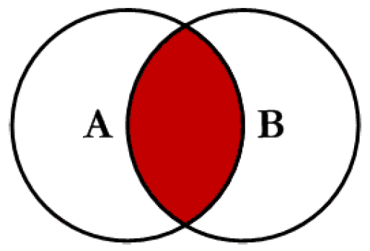
Inner Join/Natural Join
Inner Join/Natural Join produces only the set of records that match in both Table A and Table B
Most commonly used, best understood join

Slide 6
Creating Natural Joins
The NATURAL JOIN clause is based on all columns in the two tables that have the same name.
It selects rows from the two tables that have equal values in all matched columns.
If the columns having the same names have different data types, an error is returned.
Notes:
Creating Natural Joins
You can join tables automatically based on the columns in the two tables that have matching data types and names. You do this by using the NATURAL JOIN keywords.
Note: The join can happen on only those columns that have the same names and data types in both tables. If the columns have the same name but different data types, then the NATURAL JOIN syntax causes an error.

Slide 7
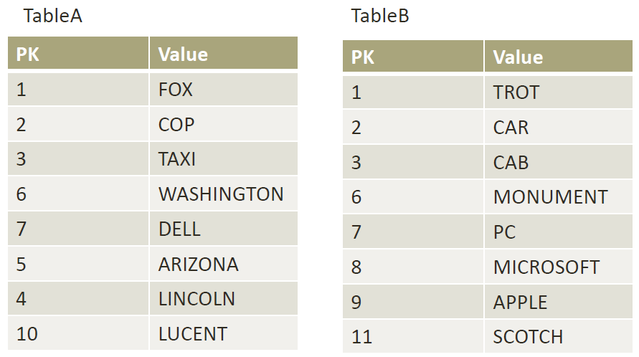
Sample Tables

Slide 8
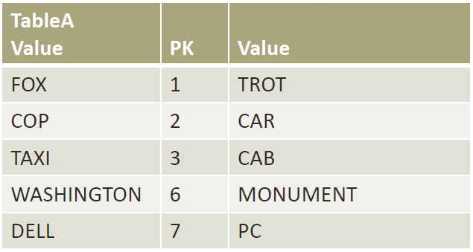
Inner Join
SELECT * FROM TableA INNER JOIN TableB ON TableA.PK = TableB.PK
This is the same as doing SELECT * FROM TableA, TableB WHERE TableA.PK = TableB.PK

Slide 9
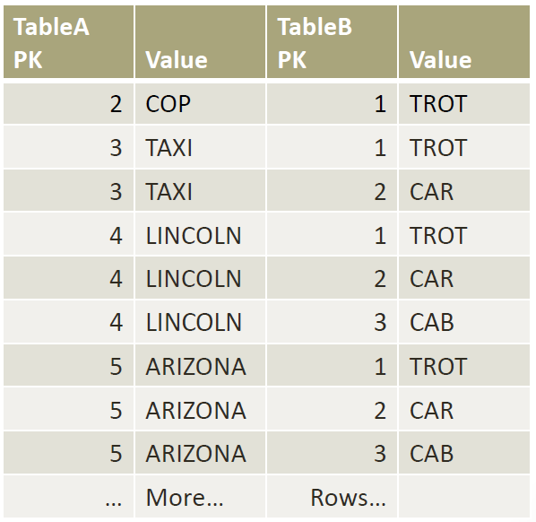
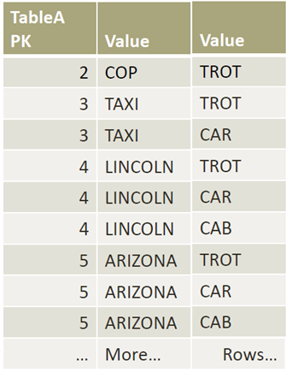
Inner Join
Inner Joins do not have to use equality to join the fields
Can use <, >, <>
Ex: SELECT * FROM TableA INNER JOIN TableB ON TableA.PK > TableB.PK

Slide 10
Inner Join/Natural Join
A NATURAL join is just an inner join where the join is implicitly created using any matching columns between the two tables
SELECT * FROM TableA NATURAL JOIN TableB

Slide 11
Natural Join in SQL
Natural join matches tuples with the same values for all common attributes, and retains only one copy of each common column.
List the names of instructors along with the course ID of the courses that they taught
select name, course_id from students, takes where student.ID = takes.ID;
Same query in SQL with “natural join” construct
select name, course_id from student natural join takes;

Slide 12
Natural Join in SQL (Cont.)
The from clause can have multiple relations combined using natural join:
select A₁, A₂, … A_{n} from r₁ natural join r₂ natural join .. natural join r_{n} where P ;

Slide 13
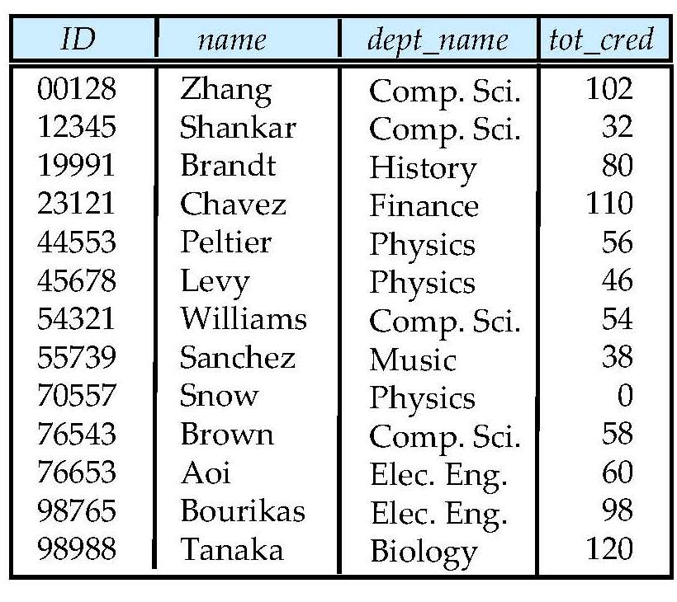
Student Relation

Slide 14
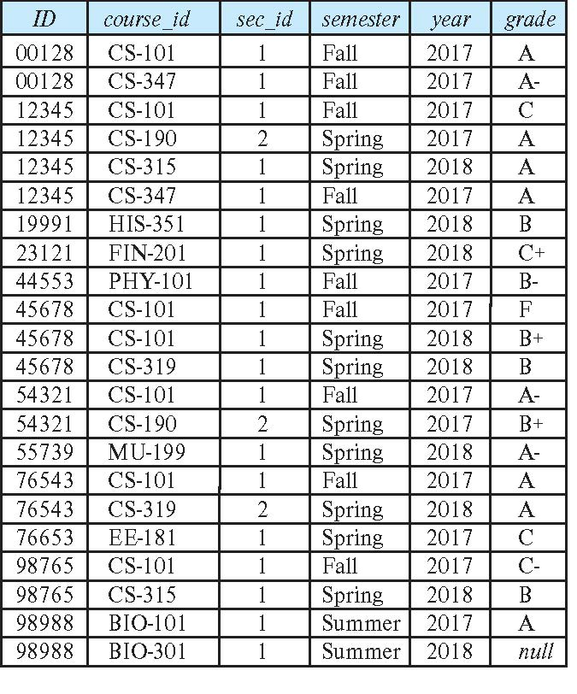
Takes Relation

Slide 15
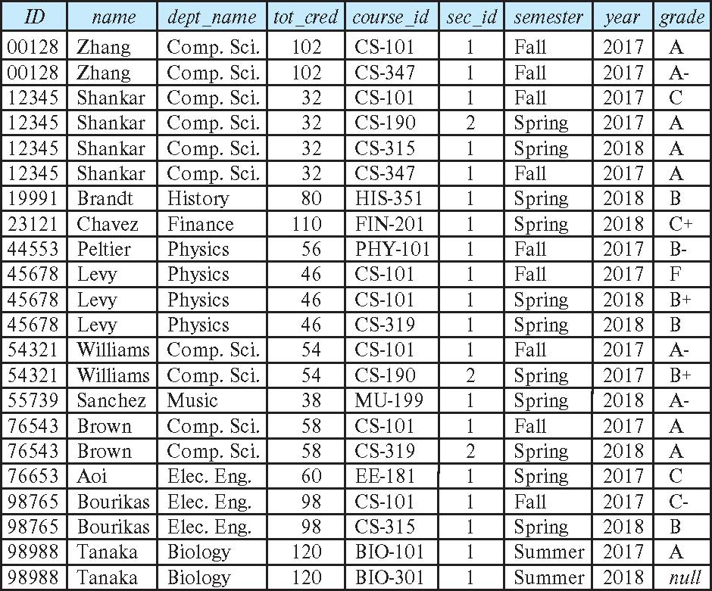
student natural join takes

Slide 16
Dangerous in Natural Join
Beware of unrelated attributes with same name which get equated incorrectly
Example -- List the names of students instructors along with the titles of courses that they have taken
Correct version
select name, title from student natural join takes, course where takes.course_id = course.course_id;
Incorrect version
select name, title from student natural join takes natural join course;
This query omits all (student name, course title) pairs where the student takes a course in a department other than the student's own department.
The correct version (above), correctly outputs such pairs.

Slide 17
Natural Join with Using Clause
To avoid the danger of equating attributes erroneously, we can use the “using” construct that allows us to specify exactly which columns should be equated.
Query example
select name, title from (student natural join takes) join course using (course_id)

Slide 18
Join Condition
The on condition allows a general predicate over the relations being joined
This predicate is written like a where clause predicate except for the use of the keyword on
Query example
select * from student join takes on student_ID = takes_ID
The on condition above specifies that a tuple from student matches a tuple from takes if their ID values are equal.
Equivalent to:
select * from student , takes where student_ID = takes_ID

Slide 19
Outer Join
An extension of the join operation that avoids loss of information.
Computes the join and then adds tuples form one relation that does not match tuples in the other relation to the result of the join.
Uses null values.
Three forms of outer join:
left outer join
right outer join
full outer join

Slide 20
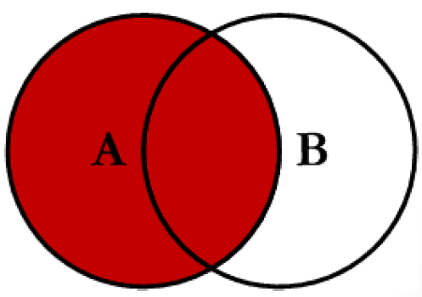
Left Outer Join
Left outer join produces a complete set of records from Table A, with the matching records (where available) in Table B. If there is no match, the right side will contain null.

Slide 21
Sample Tables

Slide 22
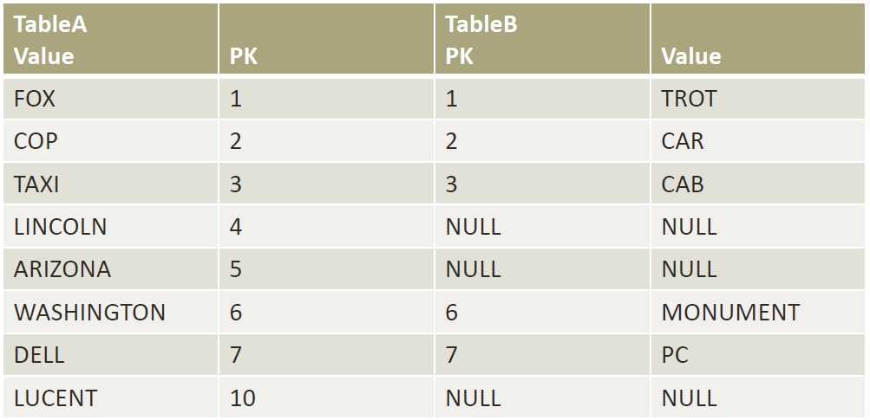
Left Outer Join
SELECT * FROM TableA LEFT OUTER JOIN TableB ON TableA.PK = TableB.PK
Tables Before Left Outer Join

Slide 23
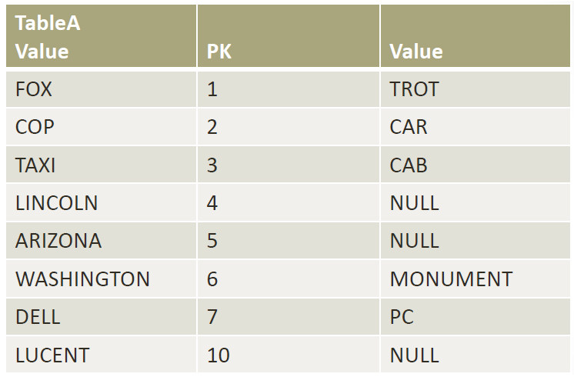
Left Outer Join
No matching tuples

Slide 24
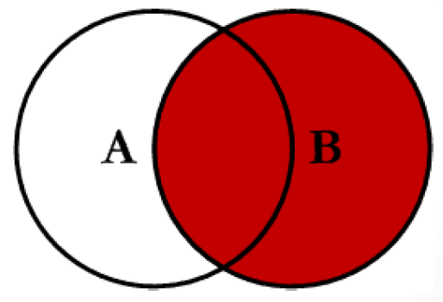
Right Outer Join
Right outer join produces a complete set of records from Table B, with the matching records (where available) in Table A. If there is no match, the left side will contain null.

Slide 25
Sample Tables

Slide 26
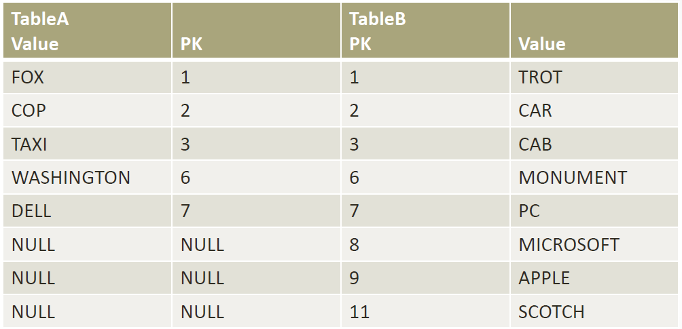
Right Outer Join
SELECT * FROM TableA RIGHT OUTER JOIN TableB ON TableA.PK = TableB.PK
Tables Before Right Outer Join

Slide 27
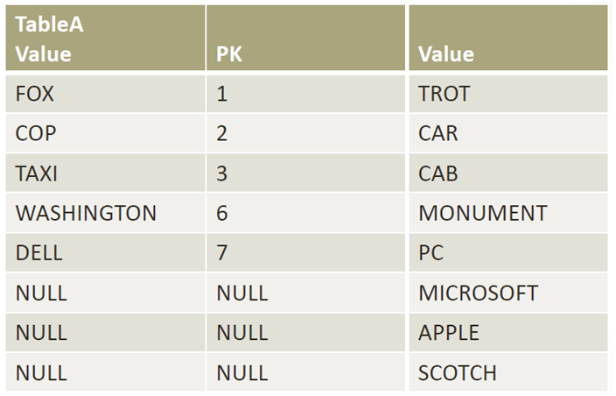
Right Outer Join
No matching tuples

Slide 28
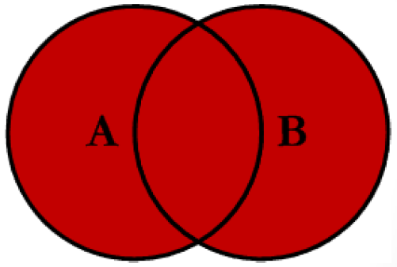
Full Outer Join
Full outer join produces the set of all records in Table A and Table B, with matching records from both sides where available. If there is no match, the missing side will contain null.

Slide 29
Sample Tables

Slide 30
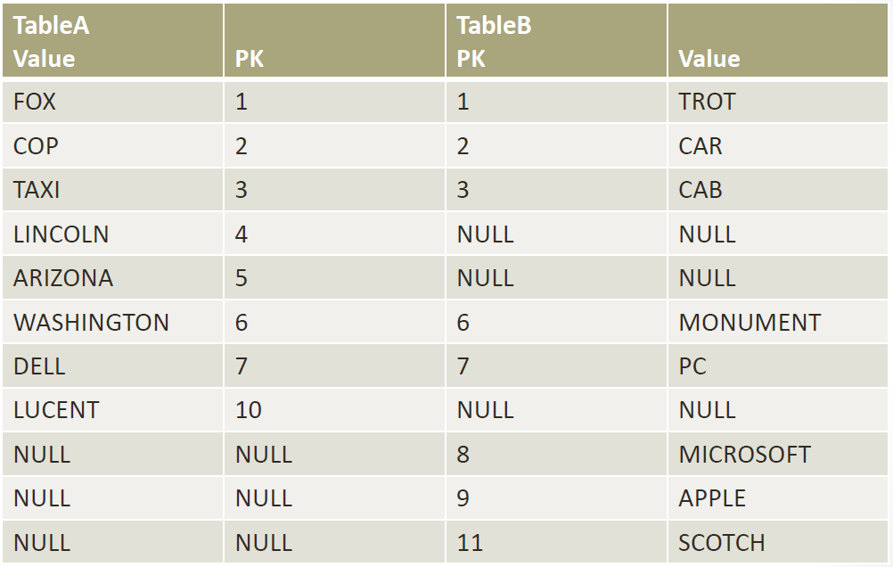
Full Outer Join
SELECT * FROM TableA FULL OUTER JOIN TableB ON TableA.PK = TableB.PK
Tables Before Full Outer Join

Slide 31
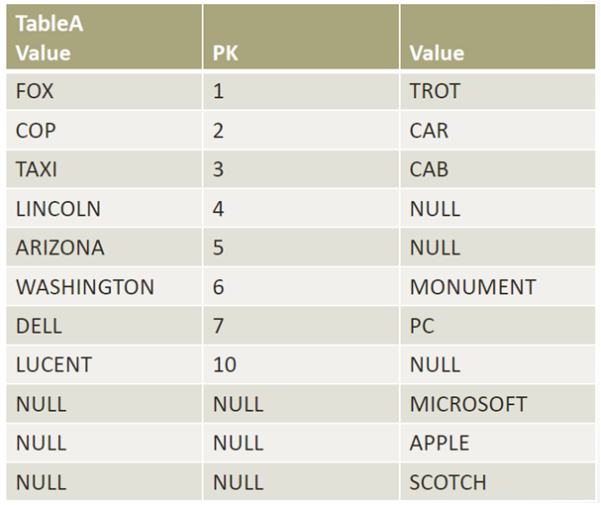
Full Outer Join

Slide 32
Full Outer Join in MySQL
MySQL does not have FULL OUTER JOIN support
Can be simulated using UNION, LEFT and RIGHT JOINs
SELECT * FROM TableA LEFT JOIN TableB ON TableA.PK = TableB.PK
UNION
SELECT * FROM TableA RIGHT JOIN TableB ON TableA.PK = TableB.PK

Slide 33
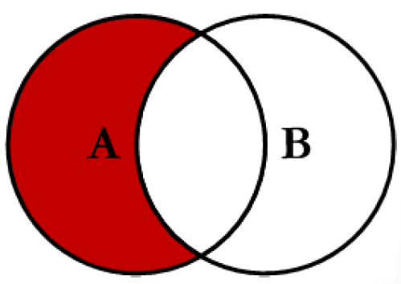
Left Join Excluding Inner Join
This query will return all of the records in the left table (table A) that do not match any records in the right table (table B).

Slide 34
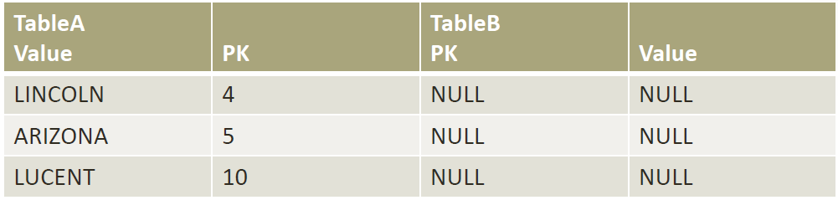
Left Join Excluding Inner Join
SELECT * FROM TableA LEFT JOIN TableB ON TableA.PK = TableB.PK WHERE TableB.PK IS NULL
Perform left outer join, then exclude the records we do not want from the right side via a where clause.

Slide 35
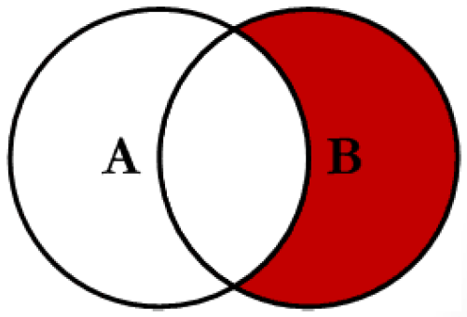
Right Join Excluding Inner Join
This query will return all of the records in the right table (table B) that do not match any records in the left table (table A).

Slide 36
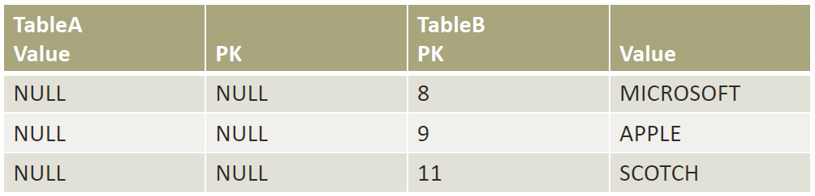
Right Join Excluding Inner Join
SELECT * FROM TableA RIGHT JOIN TableB ON TableA.PK = TableB.PK WHERE TableA.PK IS NULL

Slide 37
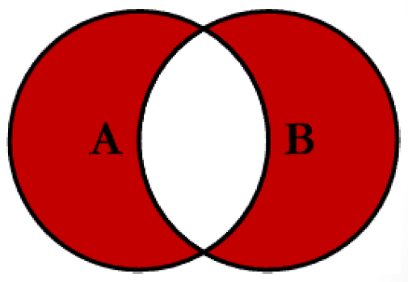
Full Outer Join Excluding Outer Join
This query will return all of the records in Table A and Table B that do not have a matching record in the other table.

Slide 38
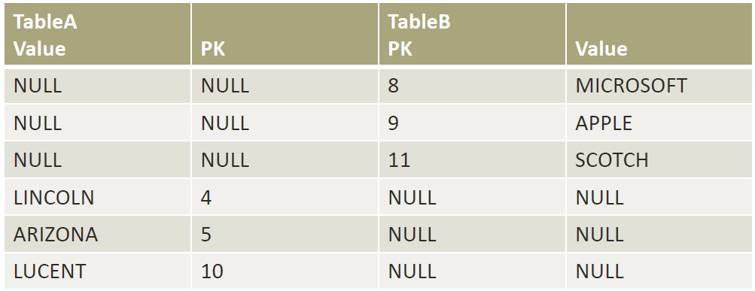
Full Outer Join Excluding Inner Join
SELECT * FROM TableA FULL OUTER JOIN TableB ON TableA.PK = TableB.PK WHERE TableA.PK IS NULL OR TableB.PK IS NULL

Slide 39
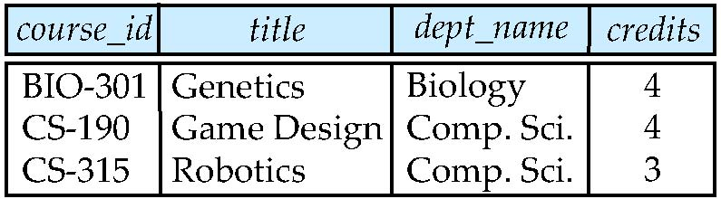
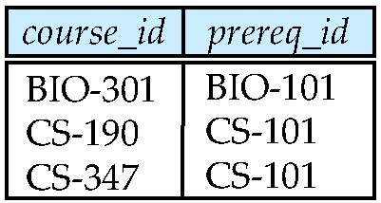
More Outer Join Examples
Relation (Table) course
Relation (Table) prereq
Observe that
course information is missing CS-347
prereq information is missing CS-315

Slide 40
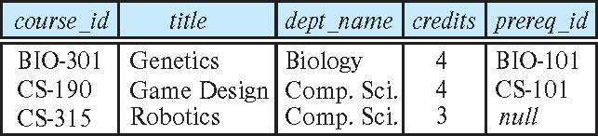
Left Outer Join
course left outer join prereq
In relational algebra: course ⟕ prereq

Slide 41
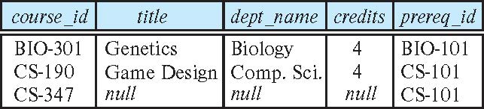
Right Outer Join
course right outer join prereq
In relational algebra: course ⟖ prereq

Slide 42
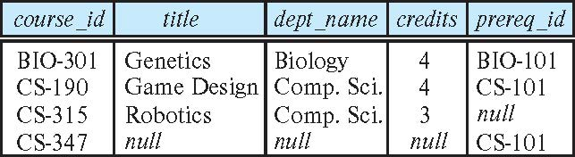
Full Outer Join
course natural full outer join prereq
In relational algebra: course ⟗ prereq

Slide 43
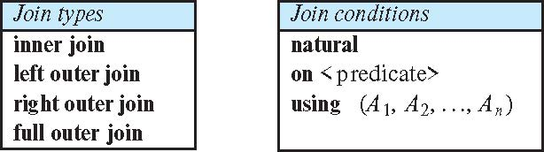
Joined Types and Conditions
Join operations take two relations and return as a result another relation.
These additional operations are typically used as subquery expressions in the from clause
Join condition – defines which tuples in the two relations match.
Join type – defines how tuples in each relation that do not match any tuple in the other relation (based on the join condition) are treated.

Slide 44
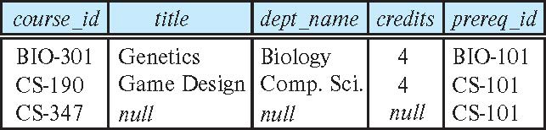
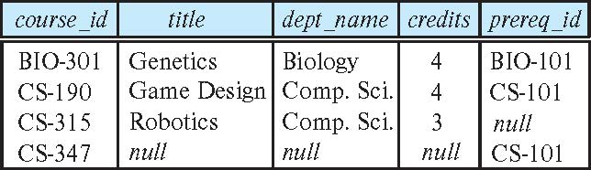
Joined Relations – Examples
course right outer join prereq
course full outer join prereq using (course_id)

Slide 45
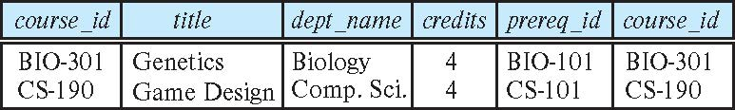
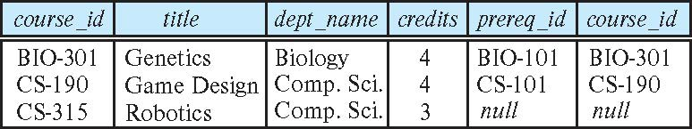
Joined Relations – Examples
course inner join prereq on course.course_id = prereq.course_id
What is the difference between the above, and a natural join?
course left outer join prereq on course.course_id = prereq.course_id

Slide 46
Joined Relations – Examples
course natural right outer join prereq
course full outer join prereq using (course_id)

